Slide 1
HOUSING PROJECT

Slide 2
DATA SET:
The data set consist of Train data and Test data.
Train dataset has 1168 records with 81 features.
Test dataset has 292 records.
Dataset has all type data like object, int and float.

Slide 3
EXPLORATORY DATA ANALYSIS:
Null Values:
The train data set has null values. Need to treat it.
LotFrontage = 45 ----> float64
MasVnrArea = 1 ----> float64
BsmtQual = 7 ----> float64
BsmtCond = 7 ----> float64
BsmtExposure = 7 ----> float64
BsmtFinType1 = 7 ----> float64
Electrical = 1 ----> float64
GarageType = 17 ----> float64
GarageYrBlt = 17 ----> float64
GarageQual = 17 ----> float64
GarageCond = 17 ----> float64
Alley = 278 ----> float64
FireplaceQu = 139 ----> float64
Fence = 248 ----> float64
MiscFeature = 282 ----> float64

Slide 4
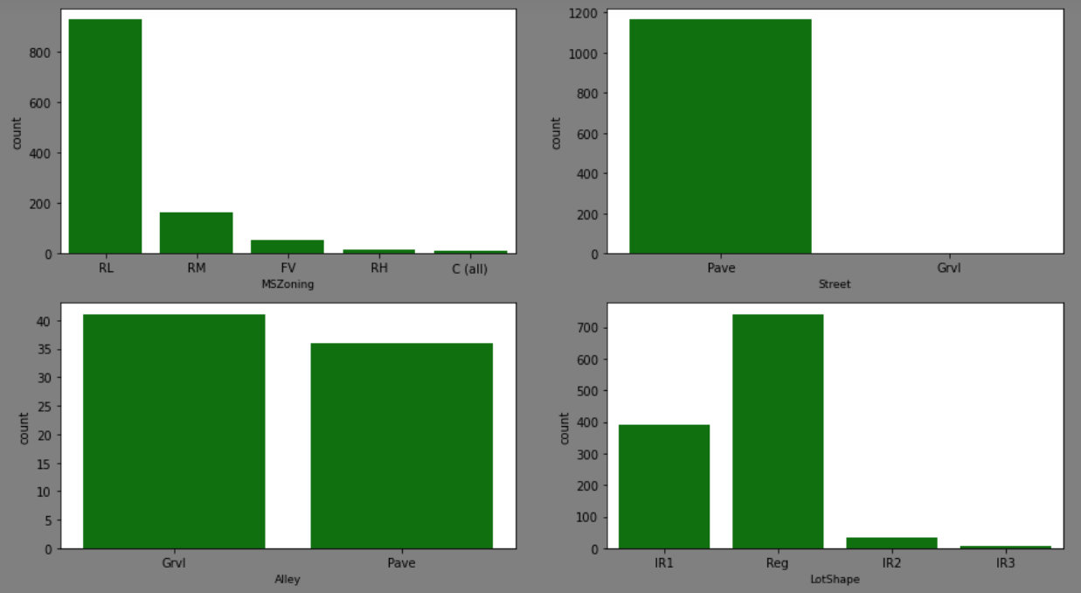
EXPLORATORY DATA ANALYSIS:
Count plot for categorical features:

Slide 5
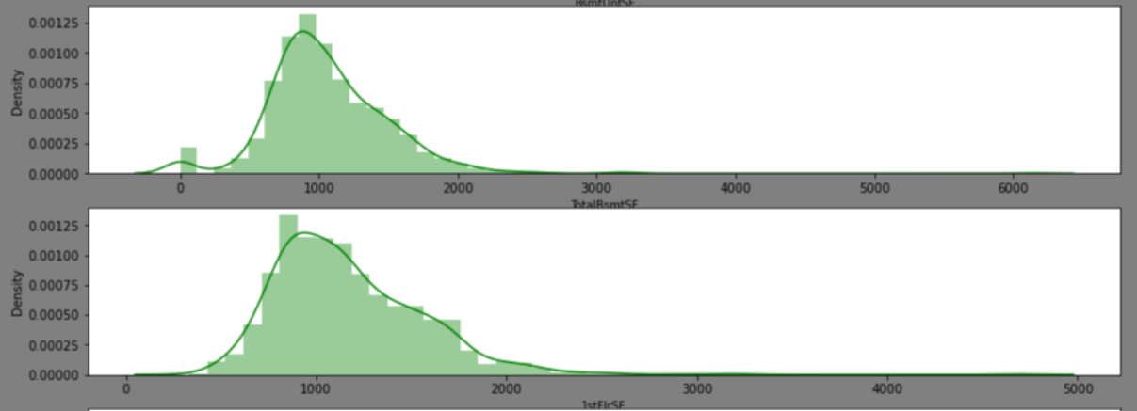
EXPLORATORY DATA ANALYSIS:
Distribution plot for continuous features:

Slide 6
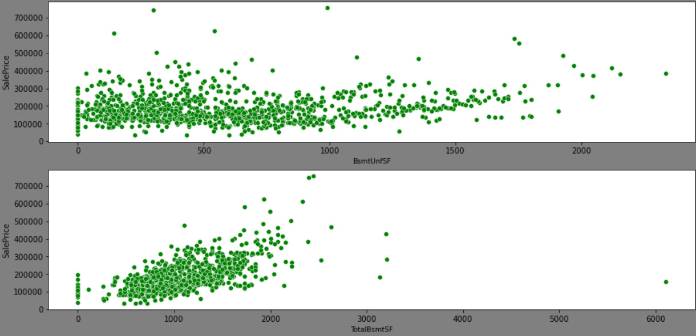
EXPLORATORY DATA ANALYSIS:
Scatter plot :
To understand the distribution and relation with target variable.

Slide 7
DATA PREPROCESSING:
Encoding Categorical Variables :
Categorical variables are encoded using ORDINAL ENCODER.
from sklearn.preprocessing import OrdinalEncoder
for i in data.columns:
if data[i].dtypes == 'object':
enco = OrdinalEncoder(categories=[data[i].unique()])
data[i] = enco.fit_transform(data[[i]])

Slide 8
DATA PREPROCESSING:
Dropping non Valuable features:
Some features does not have signification contribution to target label. These variables have all unique values or above 50% records have null values. So, dropping these labels as below:
'Alley’
'PoolQC’
‘Fence’
'FireplaceQu’
'MiscFeature’
'Id’
‘Utilities’
‘Street’

Slide 9
DATA PREPROCESSING:
Imputng for Null value treating:
data['LotFrontage'] = data['LotFrontage'].fillna(data['LotFrontage'].mean())
data['MasVnrType'] = data['MasVnrType'].fillna(data['MasVnrType'].mode()[0])
data['MasVnrArea'] = data['MasVnrArea'].fillna(data['MasVnrArea'].mean())
data['BsmtQual'] = data['BsmtQual'].fillna(data['BsmtQual'].mode()[0])
data['BsmtCond'] = data['BsmtCond'].fillna(data['BsmtCond'].mode()[0])
data['BsmtExposure'] = data['BsmtExposure'].fillna(data['BsmtExposure'].mode()[0])
data['BsmtFinType1'] = data['BsmtFinType1'].fillna(data['BsmtFinType1'].mode()[0])
data['BsmtFinType2'] = data['BsmtFinType2'].fillna(data['BsmtFinType2'].mode()[0])
data['GarageType'] = data['GarageType'].fillna(data['GarageType'].mode()[0])
data['GarageYrBlt'] = data['GarageYrBlt'].fillna(data['GarageYrBlt'].mode()[0])
data['GarageFinish'] = data['GarageFinish'].fillna(data['GarageFinish'].mode()[0])
data['GarageQual'] = data['GarageQual'].fillna(data['GarageQual'].mode()[0])
data['GarageCond'] = data['GarageCond'].fillna(data['GarageCond'].mode()[0])

Slide 10
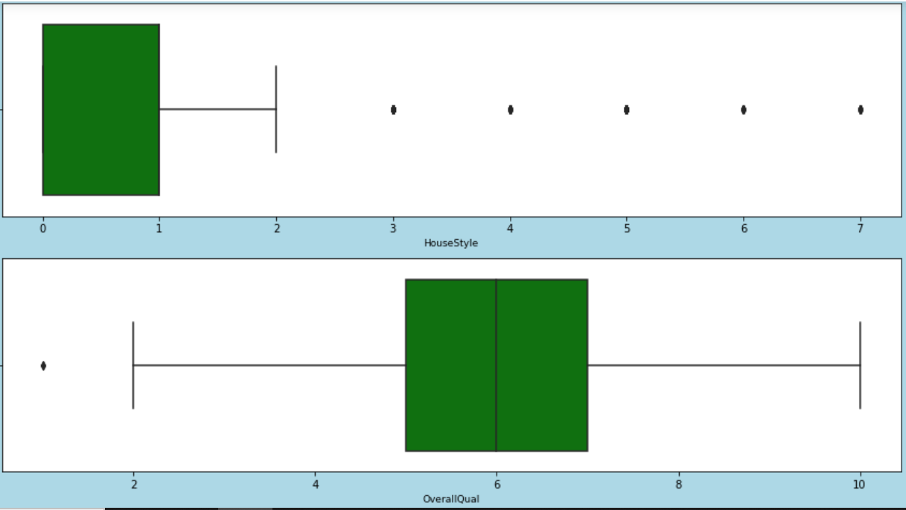
DATA PREPROCESSING:
Treating Outliers:
Outliers can be found using box Plot as below:

Slide 11
DATA PREPROCESSING:
Treating Outliers:
Outliers care treated using the calculation of Quantile method as below on each variable on which the outliers need to be treated:
SalePrice_high = q3.SalePrice + (1.5 * (iqr.SalePrice))
SalePrice_low = q1.SalePrice - (1.5 * (iqr.SalePrice))
Drop_SalePrice = np.where((data.SalePrice > SalePrice_high) | (data.SalePrice < SalePrice_low) )
Drop_SalePrice
data = data.drop(data.index[Drop_SalePrice])
data.shape

Slide 12
DATA PREPROCESSING:
Corelation:
The Features have high correlation with Target Label (SalePrice)
Below mentioned features are some variables that have high correlation.
OverallQual
GirlivArea
GarageCars
GarageArea
YearBuild and so on.
These features are treated as important for model building.

Slide 13
DATA PREPROCESSING:
Multi collinearity and low relation features:
Some features have multicollinearity problem that is both varible have some relation with each other and its sufficient to have only one feature from both which has high relation with target label.
Some features has significantly very low relation with target label. So we will drop those features.
These decisions are taken based on heat chart and correlation chart.

Slide 14
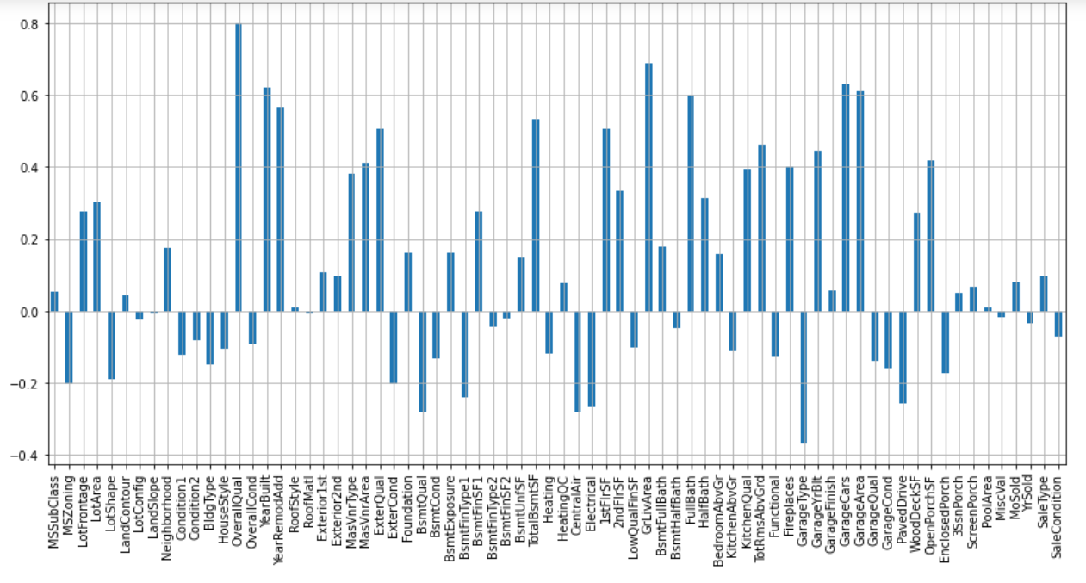
DATA PREPROCESSING:
Corelation chart:
Long bars have high relation with Target label and viceversa as well

Slide 15
MODEL BUILDING:
Train Test Split and Scaler Transformation:
For building the model we have splited Train-Test Split\
x = data.drop(columns = ['SalePrice'],axis =1)
y = data.SalePrice
Scaler tranformation carried out to break the variance in numerical ranges.
from sklearn.preprocessing import StandardScaler
scale = StandardScaler()
x_scaled = scale.fit_transform(x)

Slide 16
MODEL BUILDING:
Random State :
For building the model, we need to define the best random state. Here, we have used LINEAR REGRESSION for random state selection.
for i in range(0,101):
x_train,x_test,y_train,y_test = train_test_split(x_scaled,y,train_size = 0.75,random_state = i)
lr.fit(x_train, y_train)
predict_train = lr.predict(x_train)
predict_test = lr.predict(x_test)
print(f"At random state {i}, the train set accuracy is ",{r2_score(y_train,predict_train)})
print(f"At random state {i}, the test set accuracy is ",{r2_score(y_test,predict_test)})

Slide 17
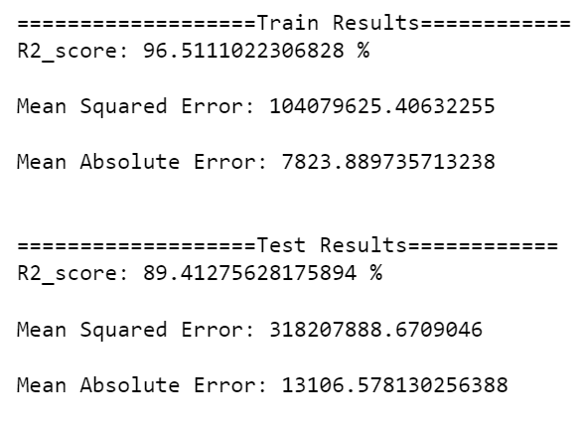
MODEL BUILDING:
Model Selection:
We have used many regression models to find the best model.
from sklearn.ensemble import RandomForestRegressor
from sklearn.tree import DecisionTreeRegressor
from sklearn.neighbors import KNeighborsRegressor
from sklearn.ensemble import GradientBoostingRegressor
After running various model, GRADIENT BOOST DECISION TREE algorithm gives the comparatively best performance as shown below.

Slide 18
MODEL BUILDING:
Cross Validation:
All the algorithms have been cross validated using K-Fold method having r2 as score.
print(cross_val_score(gbr, x_train, y_train, scoring='r2', cv=5))
print(cross_val_score(gbr, x_train, y_train, scoring='r2', cv=5).mean())
We have Cross Validation score as 86.8% for Gradient Boosting DT algorithm.

Slide 19
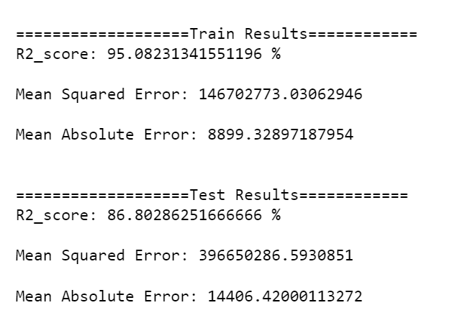
MODEL BUILDING:
Hyper-Parameter Tuning:
Hyperparameter tuning has been done for selecting the best parameters using GRIDSEARCHCV method.
We have attained optimal performance after hyperparameter tuning as shown below.

Slide 20
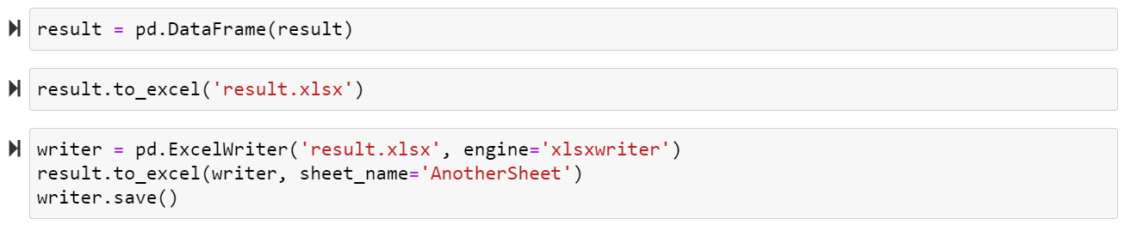
TEST DATA PREDICTION:
Prediction:
The final tuned model has been saved and used for predicting test data.
Same processing has been done as same done with train dataset to set the same result.

Slide 21
THANK YOU
END OF SLIDES

